Slide 1
AIChE Track Talk
Wednesday, April 15, 2015
Speakers: Kayane Dingilian, Caroline Werlang, Evelyn Chin, Haran Kumar

Slide 2
General ChE Required Courses
Ch/ChE9
Ch41abc
ChE 62, ChE63ab
ACM95abc
Ch21a and [Ch 21b or Ch 24a]
ChE101, ChE105
ChE103abc
ChE126
Ch/ChE91
27 Units General Science / Engineering (18 if thesis)
One of Ec11, BEM102 or BEM103
& a track!

Slide 3
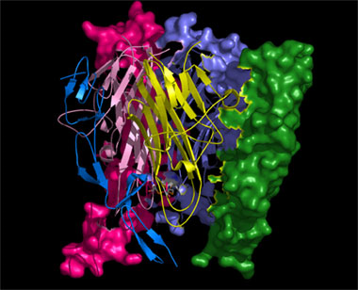
Biomolecular Track
What it includes
Biological design and engineering
Biomaterials
What you learn
Biomolecular / cell design and engineering
Molecular biology
Computational modeling
Any other areas of interest

Slide 4
Biomolecular Track: Courses
Bi/Ch 110 (1st) (junior)
BE/ChE 163 (1st or 3rd depending on 169) (junior or senior)
ChE 130 (junior or senior) or ChE90AB (senior)
Five Bioengineering / Related Electives:
Any other BE class (biomechanics, biomaterials, bio labs, evolution, biological flows, MRI)
ChE 118 or ChE 120 count

Slide 5
Sophomore Year
Ch 41a | 9 | Ch 41b | 9 | Ch 41c | 9
ChE 62 | 9 | ChE 63a | 9 | ChE 63b | 9
ACM95a | 12 | ACM95b | 12 | ACM95c | 12
Ma 2a / Ph 2a | 18 | Ma 2b / Ph 2b | 18 | Ch/ChE 9 | 8
 |  |  |  | PS 12 | 9
 |  |  |  | PE 27c | 3
Totals | 48 |  | 48 |  | 50
Junior Year
ChE 103a | 9 | ChE 103b | 9 | ChE 103c | 9
Ch 21a | 9 | Ch 24 | 9 | ChE 105 | 9
Bi/Ch 110 | 12 | ChE 101 | 9 | BE 153 | 9
Art 169 | 9 | PS/SS 139 | 9 | Pl/Law 93 | 9
CS 1 | 9 | Pl/HPS 183 | 9 | BEM 107 | 9
Totals | 48 |  | 45 |  | 45
Senior Year
ChE 126 | 9 | BE 141 | 9 | BE 159 | 9
ChE 163 | 9 | BE 150 | 9 | Law 134 | 9
L/F 109 | 9 | BE 157 | 9 | PS 120 | 9
Ch/CHE 91 | 3 | ChE 90a | 9 | ChE 90b | 9
Totals | 30 |  | 36 |  | 36

Slide 6
Biomolecular Track: Advice
Plan your schedule in advance
Remember lab classes take a lot of time
Some classes are offered alternate years
If applying to graduate school, visitation weekends are at the end of 2nd term
Figure out which classes will count for the track; some Bi/Ch classes may not count
Talk to your advisor or Prof. Flagan
When applying for internships/jobs which are biology- related, emphasize the “biomolecular” part so recruiters know you aren’t a paint-factory/process-y ChemE

Slide 7
Future Opportunities
Graduate school
Chemical Engineering, emphasis on biology
Bioengineering, Biomedical Engineering
Quantitative/Computational Biology
Jobs
Biotechnology (Amgen, Genentech, etc.)
Pharmaceuticals (Pfizer, Roche, etc.)
Medical Research Institutes (City of Hope, etc.)
Food / Consumer Products
And if you’re ambitious… Med School

Slide 8
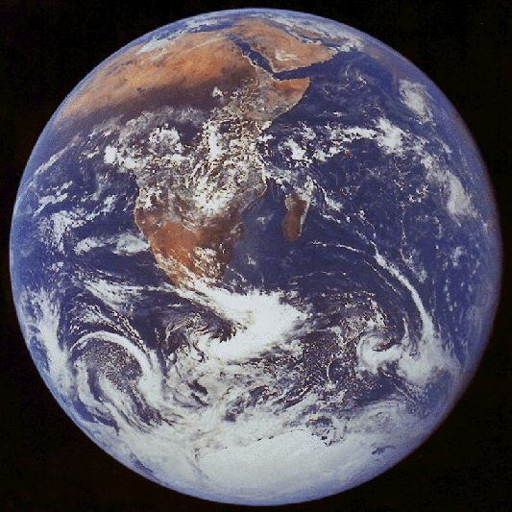
Environmental Track
The environmental track focuses on big picture concepts of the earth's systems and the chemistry, physics, and biology behind them
Core ChE curriculum provides a solid foundation for ESE courses.
Wide variety of courses to satisfy your environmental interests
Research is mainly in atmospheric chemistry and physics

Slide 9
Fall | Winter | Spring
ESE 101: Earth’s Atmosphere | ESE 103: Biogeochemical Cycles | ESE/Ch/Ge 175b: Environmental Organic Chemistry Hoffman
ESE 102: Earth’s Oceans |  | Ge/ESE/CE 226: Sediment Transport Mechanics and Morphodynamics
ESE 142: Aquatic Chemistry Adkins |  | Ge/ESE 149: Marine Geochemistry Adkins
Ge/ESE 143: Organic Geochemistry Sessions |  | ESE/Ge 152: Atmospheric Radiation Yung
ESE 150a: Seminar | ESE 150b: Seminar | ESE 150c: Seminar
ACM/ESE 118: Methods in Applied Statistics and Data Analysis Candes |  | ESE/Ge 153: Atmosphere and Ocean Dynamics Richardson
ESE/Ge 173: Topics in Atmosphere and Ocean Dynamics Schneider | Ge/ESE 154: Readings in Paleoclimate | ESE/Ge 173: Topics in Atmosphere and Ocean Dynamics
 | ChE/ESE 158: Aerosol Physics and Chemistry Flagan | Ge/ESE 155 Paleoceanography
ESE/Bi 166: Microbial Physiology Leadbetter | ESE/Bi 168: Microbial Metabolic Diversity Leadbetter | Ge/ESE 170: Microbial Ecology Orphan
ESE/Ge/Ch 172: Atmospheric Chemistry II Wennberg/Seinfeld |  | ESE/Ge/Ch 171: Atmospheric Chemistry Wennberg/Seinfeld
ESE 101: Current Problems in Environmental Science and Engineering Wennberg | ESE/Ch/Ge 175a: Environmental Organic Chemistry Hoffman

Slide 10
Sophomore Year
Ch 41a (Bi 122) | 9 | Ch 41b (L 103 b) | 9 | Ch 41c (Ay 1) | 9
ChE 62 (L 103a) | 9 | ChE 63a | 9 | ChE 63b | 9
ACM 95a | 12 | ACM 95b | 12 | ACM 95c | 12
Ma 2a | 9 | Ma 2b | 9 | Ch/ChE 9 (H108b) | 9
Ph 12a | 9 | Ph 12b | 9 | PE 24 | 3
ChE 80 | 6 |  |  | BEM/Ec 146 | 9
Totals | 54 |  | 51 |  | 51
Junior Year
ChE 103a | 9 | ChE 103b | 9 | ChE 103c | 9
Ch 21a | 9 | Ch 21b | 9 | ChE 105 | 9
ESE 101 | 9 | ChE 101 | 9 | ESE 171 | 9
ESE 102 | 9 | ESE 103 | 9 | ESE 158 | 9
PS 12 | 9 | En110 | 9 | HPS 167 | 9
 |  | Ch/ChE 91 | 3 | ChE 80 | 6
Totals | 45 |  | 48 |  | 51
Senior Year
ChE 90a | 9 | ChE 90b | 9 | ChE 120 | 9
ChE 126 | 9 | PS 139 | 9 | ESE XXX | 9
ESE 130 | 9 | Ec 11 | 9 | ESE 139 | 9
En XXX | 9
Totals | 36 |  | 27 |  | 27

Slide 11
Environmental Track Advice
Know your options, plan ahead
Wide range of ESE classes to take, very flexible
ESE 100 series as prerequisites
Can find particular sequences of ESE classes after that
ESE 158 and ESE 171 are good courses to take
When planning, keep track of alternating years
Keep first term senior year light
Do research!
Profs Flagan, Seinfeld are titans in the aerosol community
Skills gained from research valuable in other fields

Slide 12
Future Opportunities
Well equipped to tackle world’s most pressing problems
Climate change, clean water, clean air, clean energy, health
Graduate School (Chemical Engineering, Environmental Sci./Eng.)
Energy Companies
They have a stake in renewable energy and their impact
Government (Regulatory Agencies)
Large volume of positions, but not too many entry level
Once you're in, you're in
Environmental Consulting

Slide 13
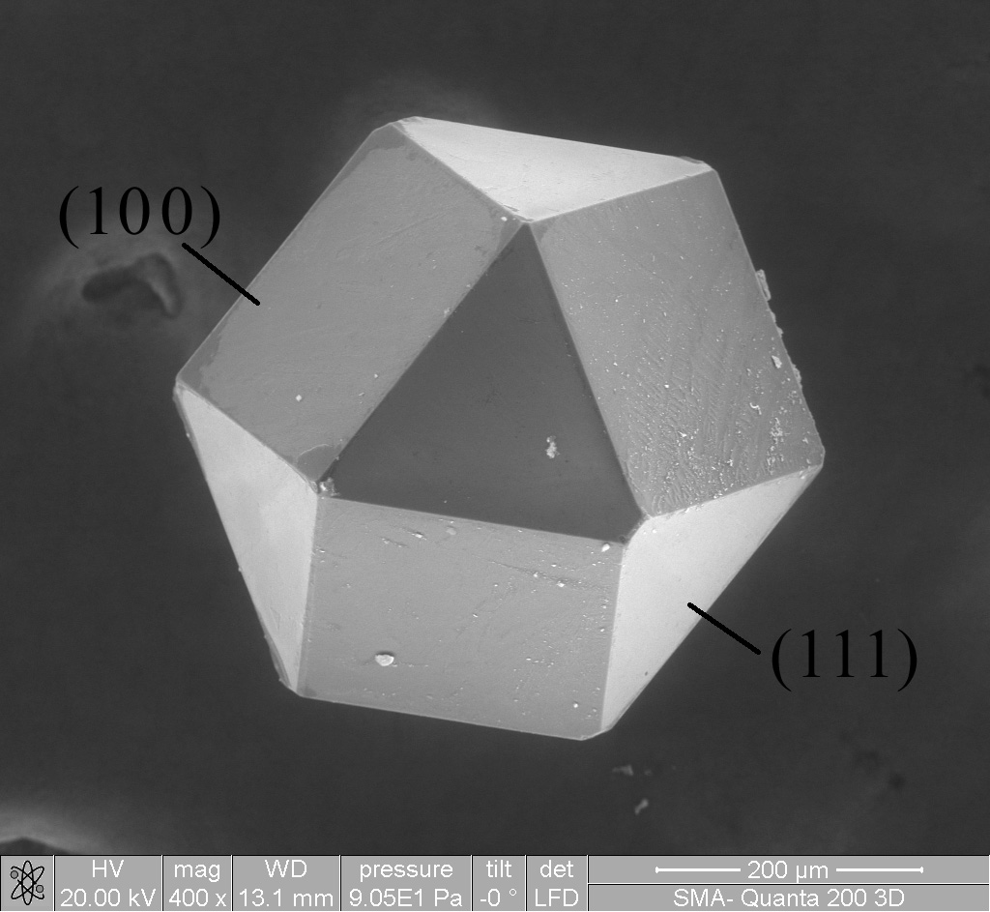
Materials Track
Why ChE MS?
Provides solid background in processing of materials
OPTIMIZATION!

Slide 14
Materials Track Courses
Either ChE 128 or ChE90ab
One of the following: Ch/ChE 147, ChE115, or MS133
One of the following: Ch120, ChE/Ch148, MS115, MS/APh120, MS/APh122, or MS131
Five materials science elective courses
Chosen from ChE118, ChE120, ChE/Ch155, ChE/Ch164, ChE/Ch165, or any MS courses

Slide 15
Sophomore Year
Ch 41a | 9 | Ch 41b | 9 | Ch 41c | 9
ChE 62 | 9 | ChE 63a | 9 | ChE 63b | 9
ACM 95a | 12 | ACM 95b | 12 | ACM 95c | 12
Ma 2a | 9 | Ma 2b | 9 | Ch/ChE 9 | 9
Ph 2a | 9 | Ph 2b | 9 | HSS | 9
Totals | 48 |  | 48 |  | 48
Junior Year
ChE 103a | 9 | ChE 103b | 9 | ChE 103c | 9
Ch 21a | 9 | ChE 101 | 9 | ChE 105 | 9
MS115 | 9 | Ch21b | 9 | ChE 115 | 9
CS 1 | 9 | MS/ME 162 | 9 | HSS | 9
HSS | 9 | HSS | 9 | HSS | 9
Totals | 45 |  | 45 |  | 45
Senior Year
ChE 126 | 9 | ChE 90a | 9 | ChE 90b | 9
MS/APh 120 | 9 | Ch/ChE 91 | 3 | MS/EST 143 | 9
MS/APh 122 | 9 | ChE/Ch 164 | 9 | HSS | 9
HSS | 9 | HSS | 9
 |  | HSS | 9
Totals | 36 |  | 39 |  | 27

Slide 16
Materials Track Advice
Plan ahead!
Keep your course options open
If it’s offered, TAKE IT
MS courses are not always offered, even if mentioned in catalog
Courses may say “offered every other year”, but that’s a lie 90% of the time

Slide 17
Future Opportunities
Materials track is very diverse!
Grad school
Chemical Engineering
Materials Science Engineering
Industry
Electronics, Semiconductors
Polymers, Plastics
Product and Material Design
Alternative Energy, Oil

Slide 18
Process Systems Track
“Unprecedented flexibility”
ChE 128 or ChE 90ab
ChE 118 & ChE 120
Process engineering & design course
Taught by a guest lecture from industry
Probably a night class
5 ANY engineering electives
Basically you can build your own track

Slide 19
Sophomore Year
Ch 41a | 9 | Ch 41b | 9 | Ch 41c | 9
ChE 62 | 9 | ChE 63a | 9 | ChE 63b | 9
ACM 95a | 12 | ACM 95b | 12 | ACM 95c | 12
Ma 2a | 9 | Ma 2b | 9 | Ch/ChE 9 | 9
Ph 2a | 9 | Ph 2b | 9 | Ec 11 | 9
Totals | 48 |  | 48 |  | 48
Junior Year
ChE 103a | 9 | ChE 103b | 9 | ChE 103c | 9
Ch 21a | 9 | ChE 101 | 9 | ChE 105 | 9
Law 33 | 9 | Ch 21b/24 | 9 | Law 134 | 9
E 105 | 9 | E 102 | 9 | E 103 | 9
BEM 103 | 9 | BEM 101 | 9 | BEM 107 | 9
PE | 3 |  |  | Ch/ChE 91 | 3
Totals | 48 |  | 45 |  | 48
Senior Year
ChE 126 | 9 | ChE 128 | 9 | ChE 120 | 9
Eng. Elective | 9 | ChE 118 | 9 | HSS | 9
Eng. Elective | 9 | HSS | 9 | PE | 3
Eng. Elective | 9 | BEM 105 | 9
Study Abroad
Totals | 36 |  | 36 |  | 21

Slide 20
Process Systems Track Advice
Plan Ahead
Can study abroad if you want (Edinburgh)
Take electives from other tracks
Take the Ken Pickar minor (E 105, E 102, E 103)
Team based projects
Solving practical problems
Can take about 4 classes Jr & Sr year
Frosh- take more hums
Possible to double with BEM.

Slide 21
Future Opportunities
Flexible
Industry
Finance
Consulting
Grad School
If you want to do Finance/Consulting, be ChE because you love ChE. There are easier majors if you want to go that route.

Slide 22
Other Opportunities
Studying abroad is possible
Cambridge, Edinburgh, Copenhagen
Not UCL: all ChE courses are year-long
Double majoring or minoring is also possible
Usually within HSS (BEM, English)
Don’t necessarily need to overload
These things just take some planning and foresight: think about it now, if you’re interested!

Slide 23
Sophomore Year
Ch 41a | 9 |  | Ch 41b |  | 9 | Ch 41c |  | 9
ChE 62 | 9 |  | ChE 63a |  | 9 | ChE 63b |  | 9
ACM95a | 12 |  | ACM95b |  | 12 | ACM95c |  | 12
Ma 2a / Ph 2a | 18 |  | Ma 2b / Ph 2b |  | 18 | Ch 9 |  | 9
 |  |  |  |  |  | En |  | 9
Totals | 48 |  |  |  | 48 |  |  | 48
Junior Year
ChE 103a |  | 9 |  | ChE 103b | 9 | ChE 103c | 9
Ch 21a |  | 9 |  | ChE 101 | 9 | ChE 105 | 9
MS115a |  | 9 |  | Ch21b | 9 | En | 9
En |  | 9 |  | MS Elective | 9 | SS | 9
En |  | 9 |  | En | 9 | Ch/ChE91 | 3
PE |  | 3 |  |  |  | PE | 3
Totals |  | 48 |  |  | 45 |  | 42
Senior Year
Cambridge |  | ChE 90a | 9 | ChE 90b | 9
MS Elective | 9 | ChE 128 | 9 | En | 9
MS Elective | 9 | Ch/ChE 147 | 9 | SS | 9
MS Elective | 9 | En 99b | 9 | SS | 9
MS Elective | 9 | En | 9 | PE | 3
En 99a | 9
Totals | 45 |  | 45 |  | 39
Senior Year
Edinburgh |  | ChE 90a | 9 | ChE 90b | 9
MS Elective | 9 | ChE 128 | 9 | MS Elective | 9
MS Elective | 9 | Ch/ChE 147 | 9 | En 99b | 9
MS Elective | 9 | En 99a | 9 | SS | 9
En | 9 | En | 9 | PE | 3
SS | 9
Totals | 45 |  | 45 |  | 39

Slide 24
Concluding Remarks
The Tracks will not:
Affect your chances at graduate school
Affect your chances at a job too much
Affect what area you end up going into (in graduate school you can start from scratch, to a degree)
The Tracks will:
Allow you to take graduate level classes in an area of interest
Show recruiters that you can diversify into related fields

Slide 25
Questions?

